Slide 1
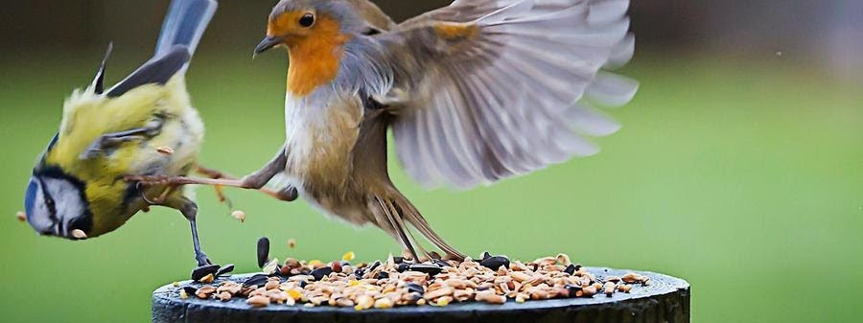
Computational Complexity The Simplified Version
Prof. Darrell Long
CSE 13S

Slide 2
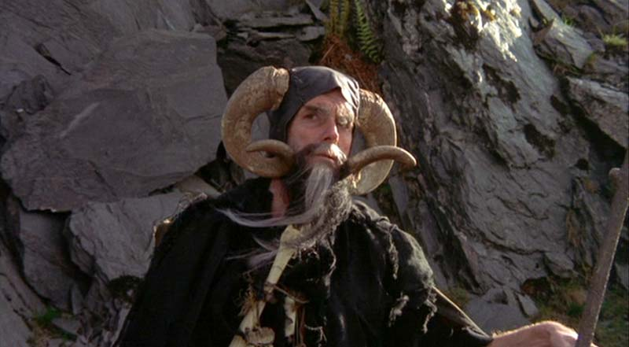
Who’s Counting?
We talk about the size of a problem:
How long is the string?
How large is the number?
How many items are in the set?
We often talk about the size of the input (like the length of a string).
We talk about the cardinality or magnitude of a number.
It is the same for numbers and strings if we write the number in unary notation:
1 = 🥕
5 = 🥕🥕🥕🥕🥕
10 = 🥕🥕🥕🥕🥕🥕🥕🥕🥕🥕
20 = 🥕🥕🥕🥕🥕🥕🥕🥕🥕🥕 🥕🥕🥕🥕🥕🥕🥕🥕🥕🥕
The problem and the algorithm that solves it define the complexity.
That’s no ordinary rabbit!
Notes:
There are some who call me, … Tim. Credit: Monty Python and the Holy Grail.

Slide 3
Some Common Functions
function | 10 | 30
log(x) | 2.30259 | 3.4012
x | 10 | 30
x log(x) | 23.0259 | 102.036
x² | 100 | 900
x³ | 1000 | 27,000
2^{x} | 1024 | 1,073,741,824
x! | 3,628,800 | 265,252,859,812,191,058,636,308,480,000,000

Slide 4
Notes:
Things to note: (i) we are using very small numbers, because these diverge quickly; (ii) they lines do cross. The later will be important for O notation.

Slide 5
Notes:
Things to note: (i) we are using very small numbers, because these diverge quickly; (ii) they lines do cross. The later will be important for O notation.

Slide 6
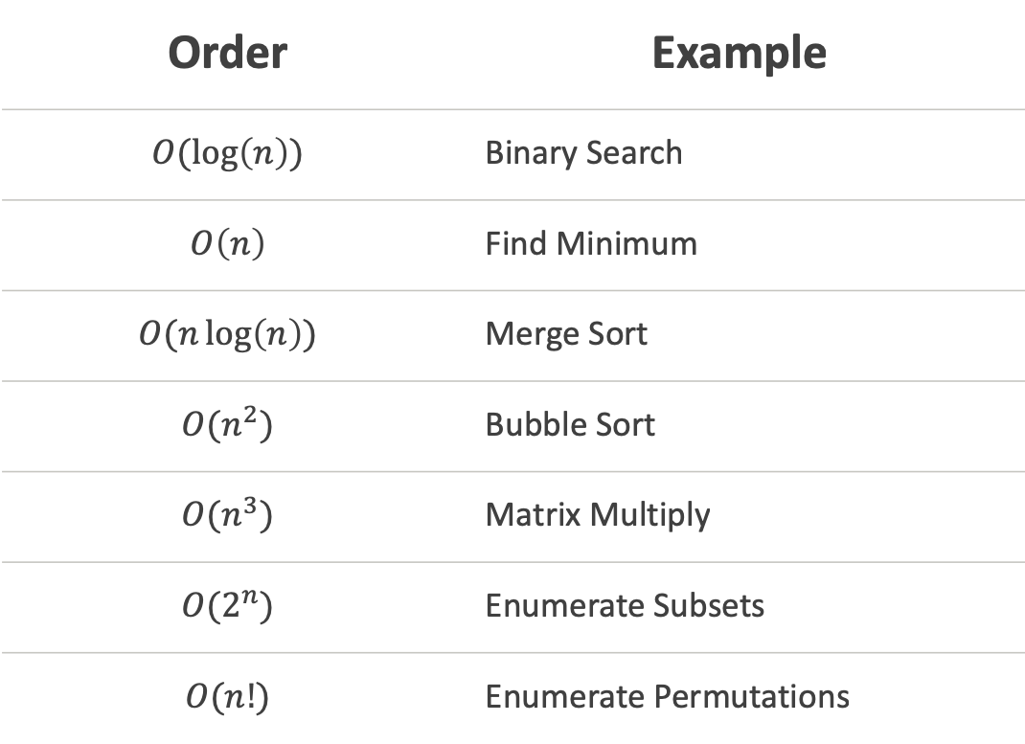
Exemplars
Order | Example
$$O(\log\left(n\right))$$ | Binary Search
$$O\left(n\right)$$ | Find Minimum
$$O(n\log\left(n\right))$$ | Merge Sort
$$O(n^{2})$$ | Bubble Sort
$$O(n^{3})$$ | Matrix Multiply
$$O(2^{n})$$ | Enumerate Subsets
$$O(n!)$$ | Enumerate Permutations

Slide 7
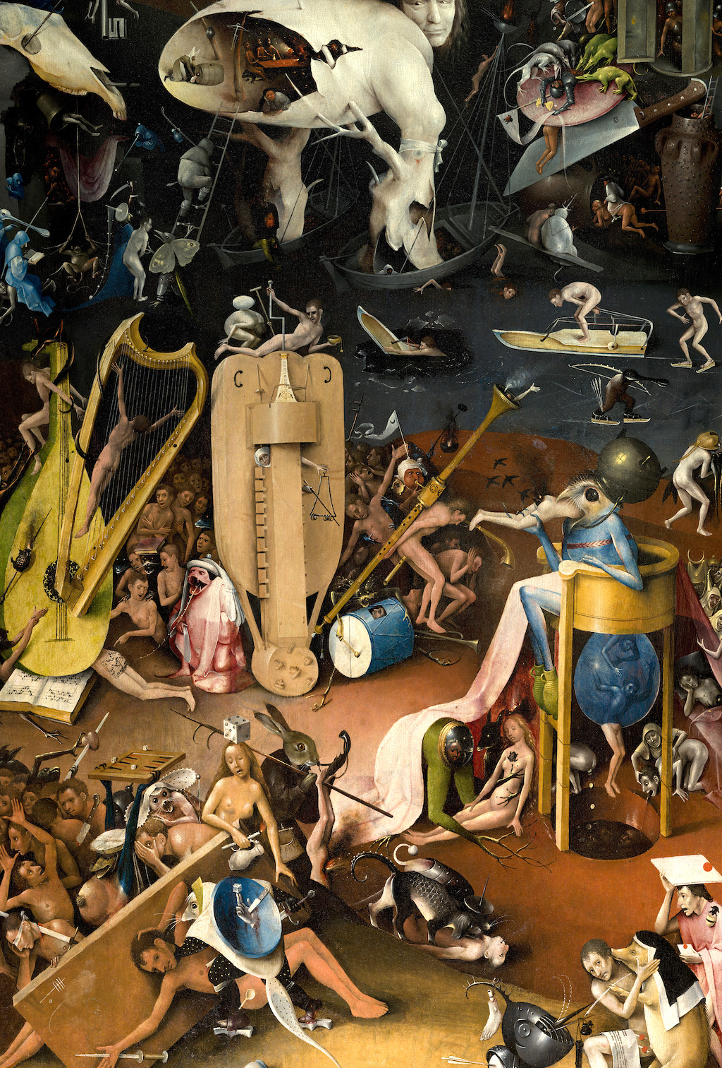
We are going to look at a little formal mathematics

Slide 8
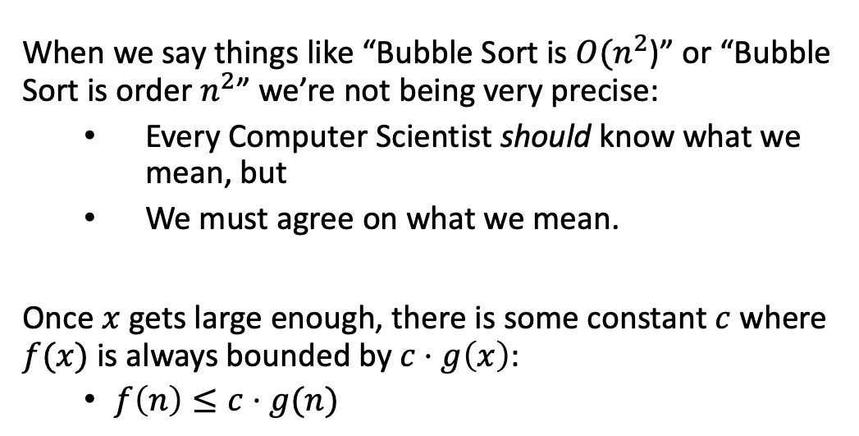
Formalities
$f\left(n\right)∈O(g\left(n\right))$ if and only if $∃c, n_{0}$ such that $∀n>n_{0},f\left(n\right)≤c⋅g(n)$
When we say things like “Bubble Sort is $O(n^{2}$)” or “Bubble Sort is order $n^{2}$” we’re not being very precise:
Every Computer Scientist should know what we mean, but
We must agree on what we mean.
Once $x$ gets large enough, there is some constant $c$ where $f(x)$is always bounded by $c⋅g\left(x\right)$:
$f\left(n\right)≤c⋅g(n)$
$O=\{f :there exist n_{0} and c such that 0 ≤f\left(n\right)≤c⋅g\left(n\right) for all n> n_{0}$}

Slide 9
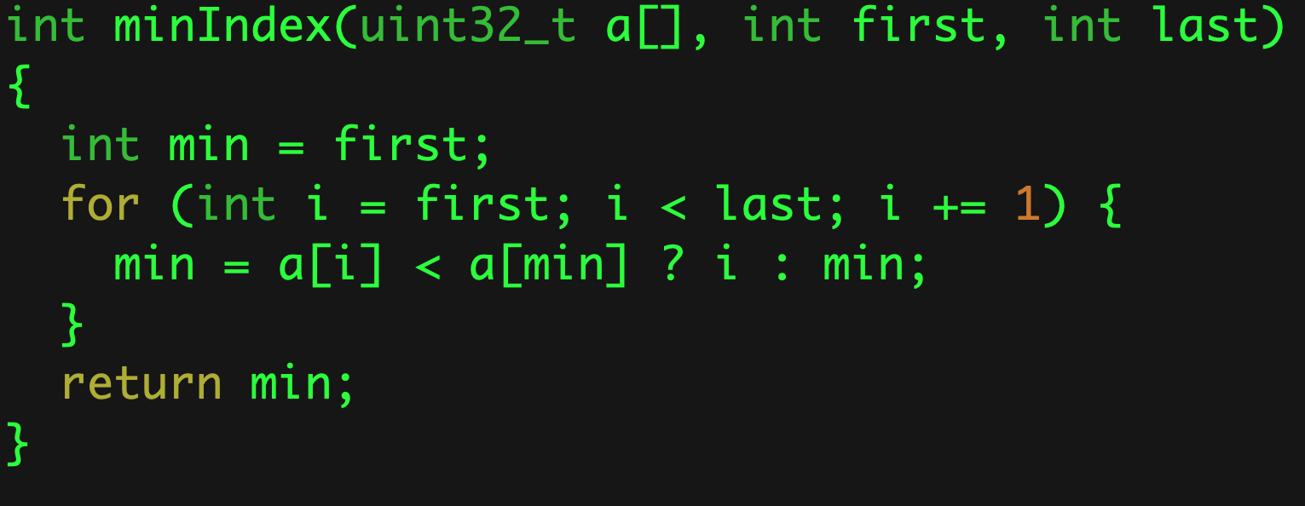


Simple Linear Algorithm
$O(n)$
$$O(n)$$

Slide 10
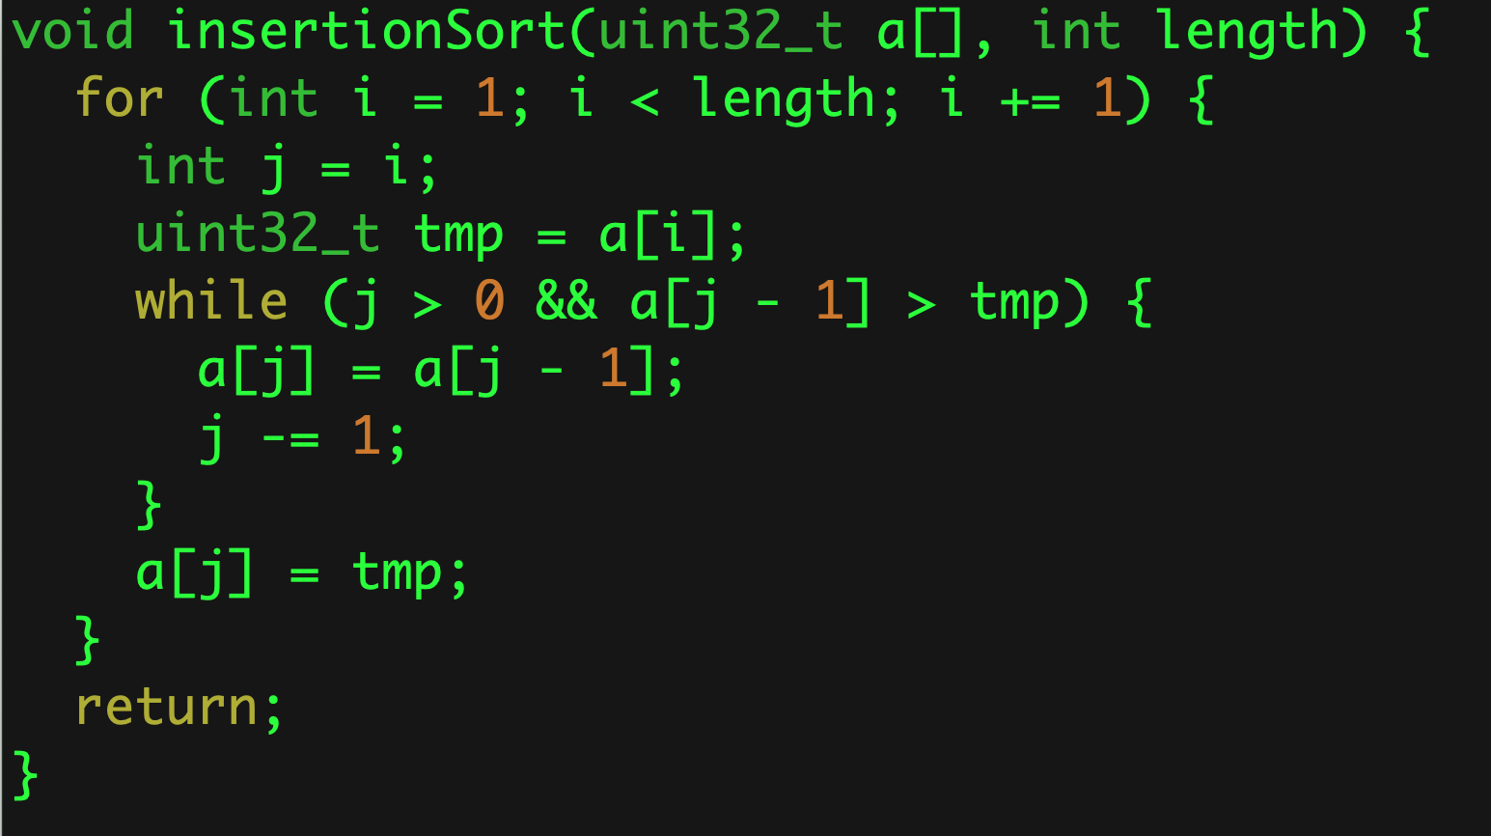


Simple Quadratic Algorithm
$$O(n2)$$
$$O(n)$$
$$O(n)$$

Slide 11
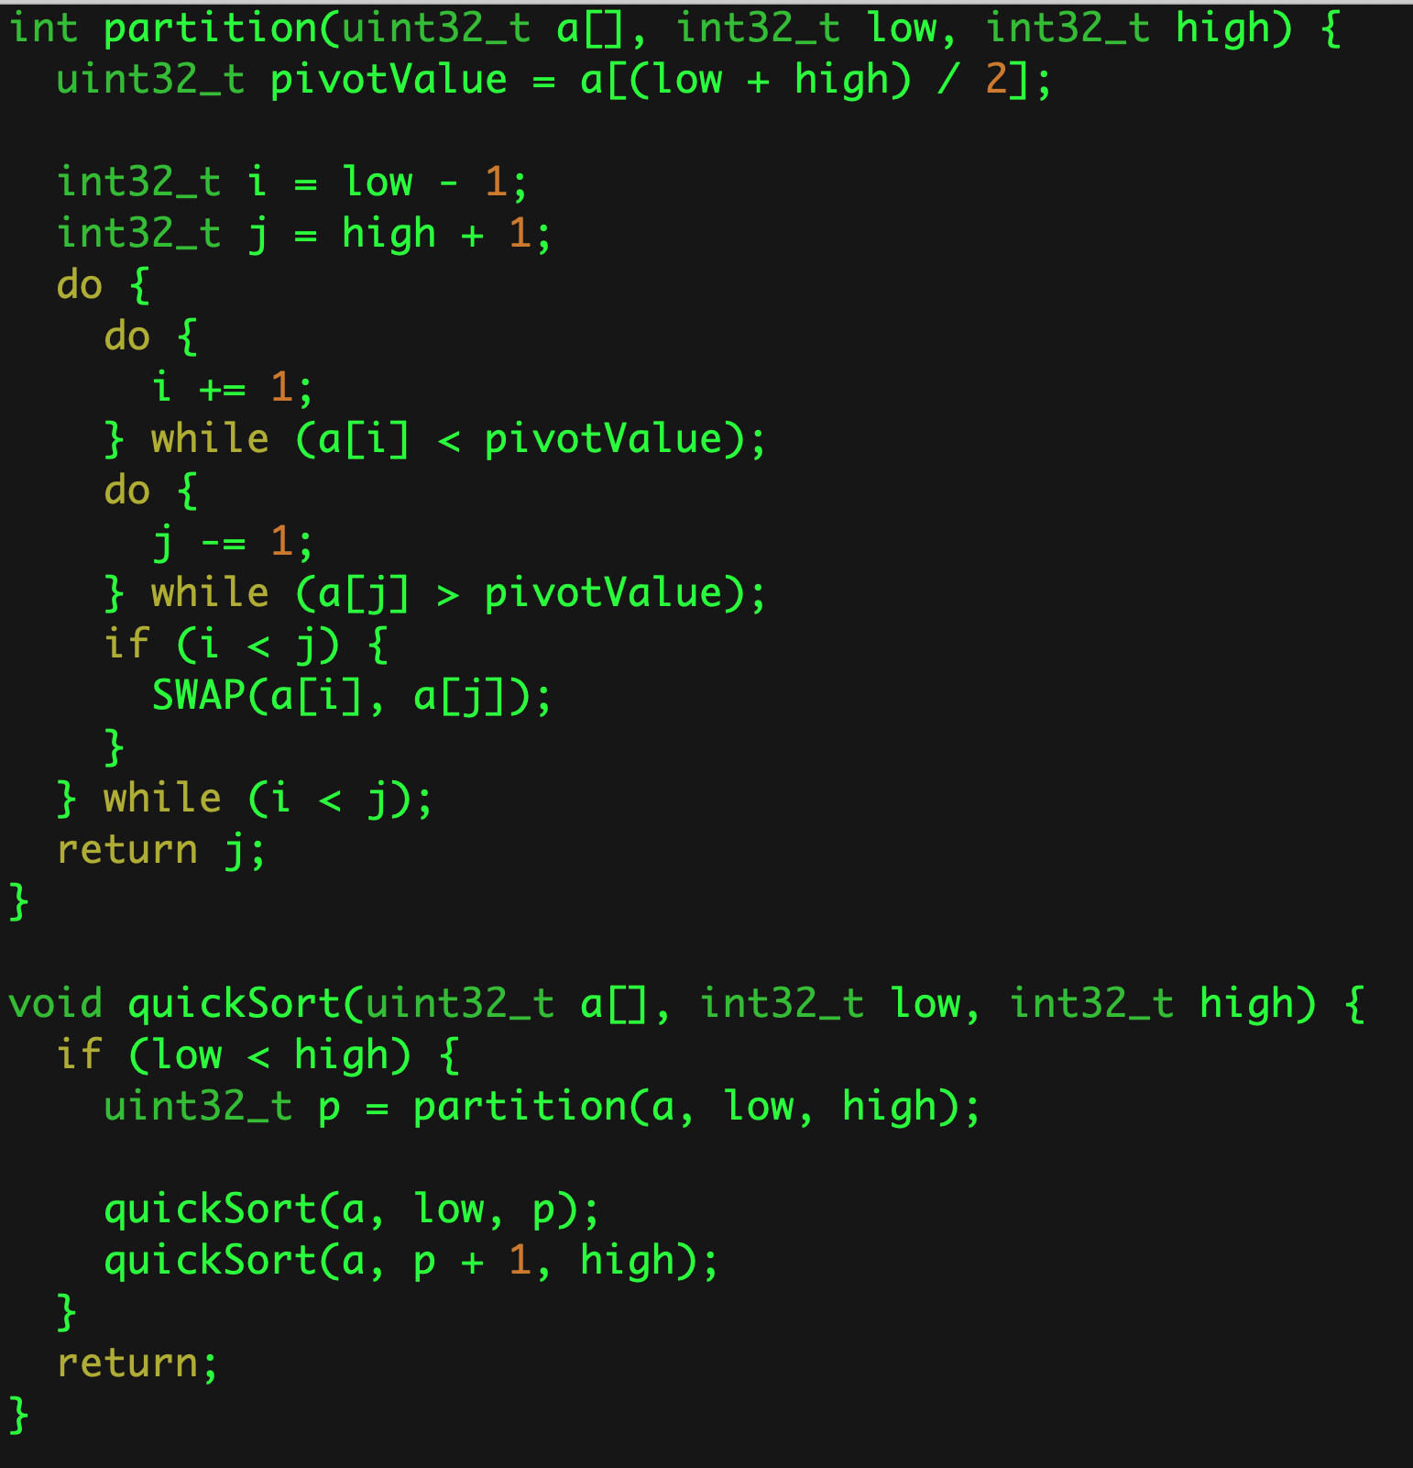



A Less Simple Algorithm
What about these?
$$O(n)$$
On Average
$$O(n log⁡(n))$$
Worst case
$$O(n2)$$
It all depends on this!
$O(\log\left(n\right))$ or $O(n)$
Notes:
Quicksort has a worst case of O(n**2), usually when the array is sorted (depending on how the pivot is chosen).

Slide 12
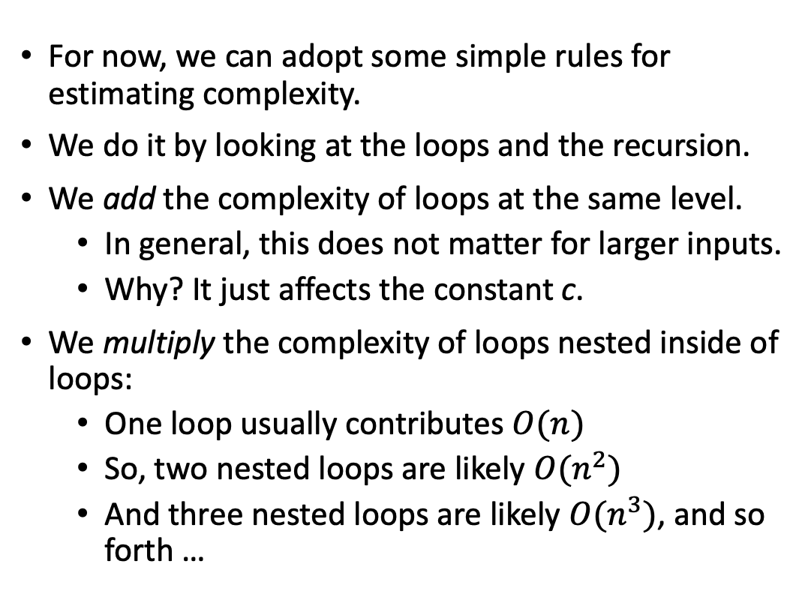
Estimating Complexity
For now, we can adopt some simple rules for estimating complexity.
We do it by looking at the loops and the recursion.
We add the complexity of loops at the same level.
In general, this does not matter for larger inputs.
Why? It just affects the constant c.
We multiply the complexity of loops nested inside of loops:
One loop usually contributes $O(n)$
So, two nested loops are likely $O(n^{2})$
And three nested loops are likely $O(n^{3})$, and so forth …

Slide 13
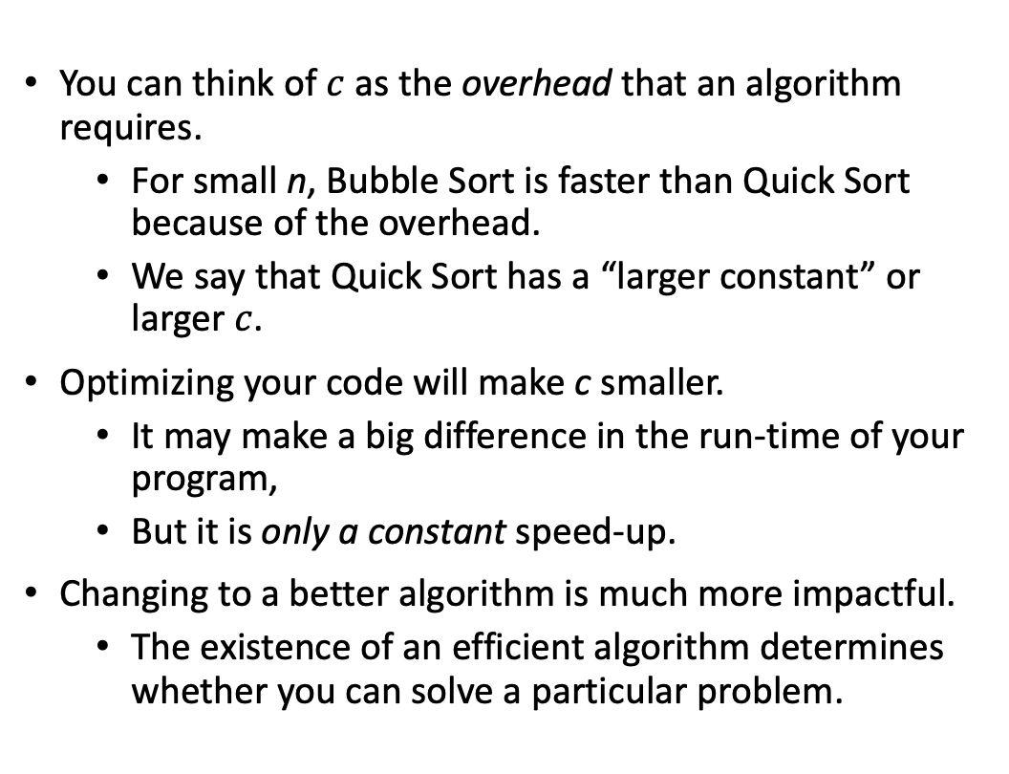
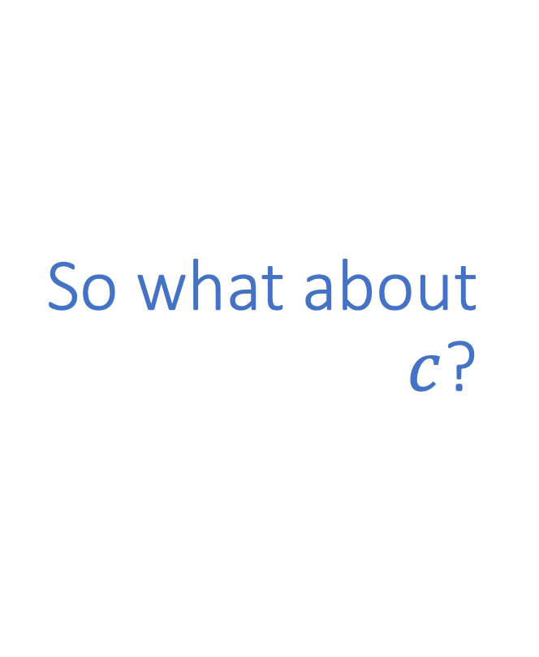
So what about $c$?
You can think of $c$ as the overhead that an algorithm requires.
For small n, Bubble Sort is faster than Quick Sort because of the overhead.
We say that Quick Sort has a “larger constant” or larger $c$.
Optimizing your code will make c smaller.
It may make a big difference in the run-time of your program,
But it is only a constant speed-up.
Changing to a better algorithm is much more impactful.
The existence of an efficient algorithm determines whether you can solve a particular problem.

Slide 14
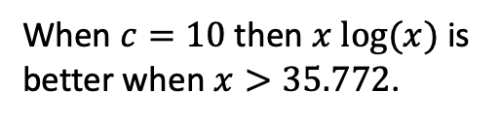
Consider $x^{2}−10 x log⁡(x)$
When $c=10$ then $x log⁡(x)$ is better when $x>35.772$.

Slide 15
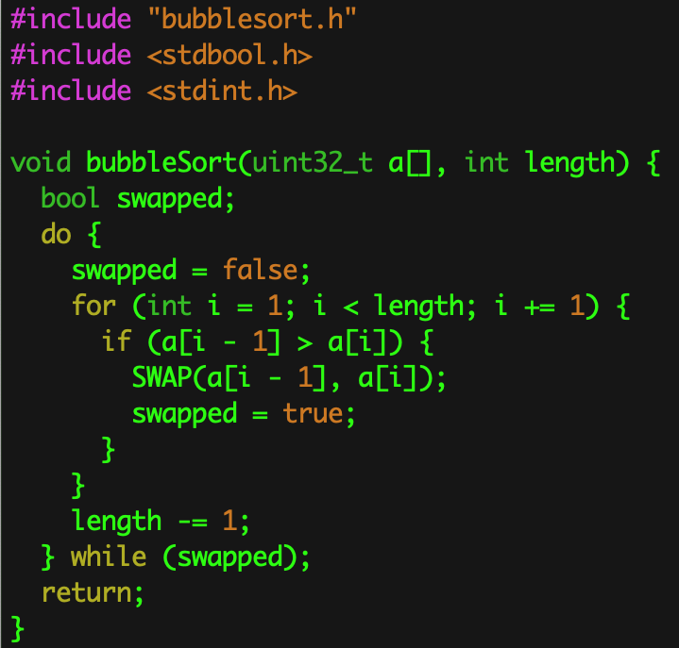
What does that tell me?
It’s probably better to use Bubble Sort for less than 50 items.

Slide 16
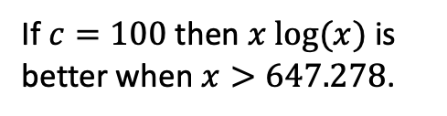
Consider $x^{2}−100 x log⁡(x)$
If $c=100$ then $x log⁡(x)$ is better when $x>647.278$.

Slide 17
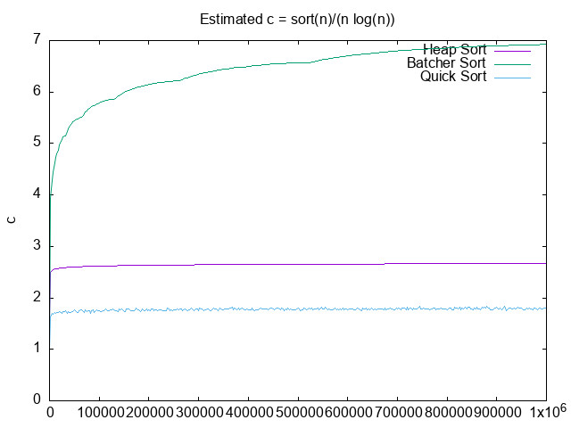
What about c?
c can have several components.
It can be time.
It can be steps.

Slide 18
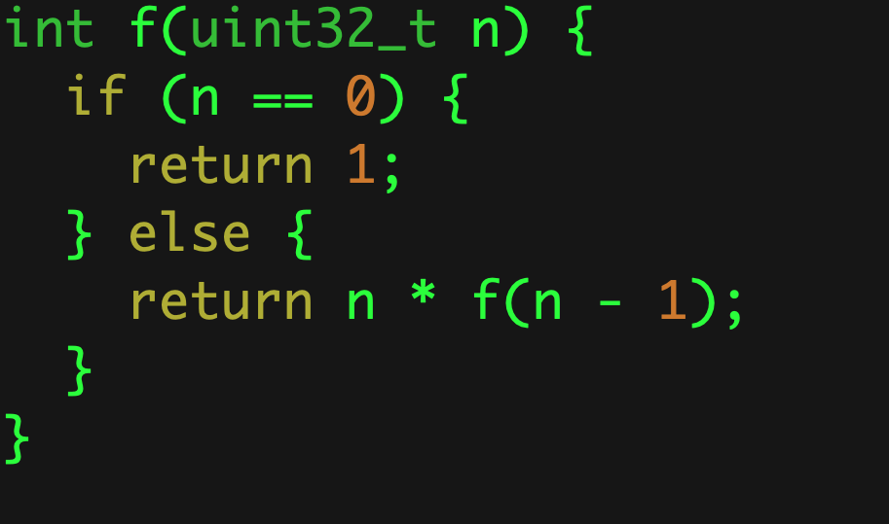

So, what about recursion?
$$O(n)$$

Slide 19
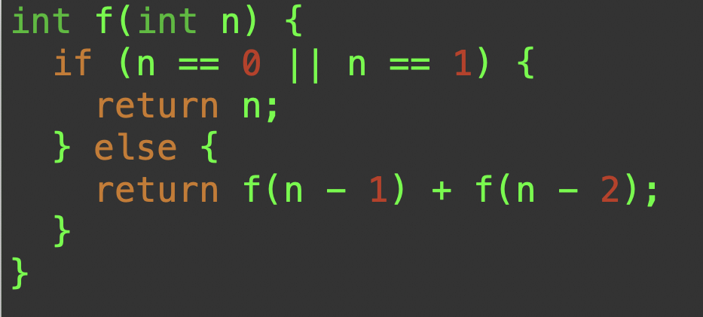

What about this one?
$$O\left({\left(\frac{1+\sqrt{5}}{2}\right)}^{n}\right)< O(2^{n})$$
Notes:
The tight upper-bound is actually O(𝜑^{n}) where 𝜑 is the Golden Ratio.

Slide 20
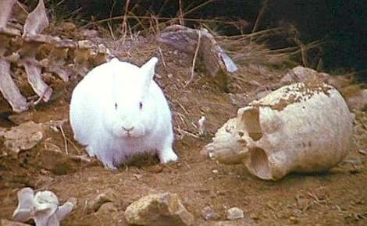

Recursive Fibonacci
$$f\left(0\right)=0$$
$$f\left(1\right)=1$$
$$f\left(n\right)=f\left(n−2\right)+f(n−1)$$
It all started with Leonardo Pisano wondering about cute little bunnies!
Notes:
Credit: https://twodee.org/blog/15956

Slide 21
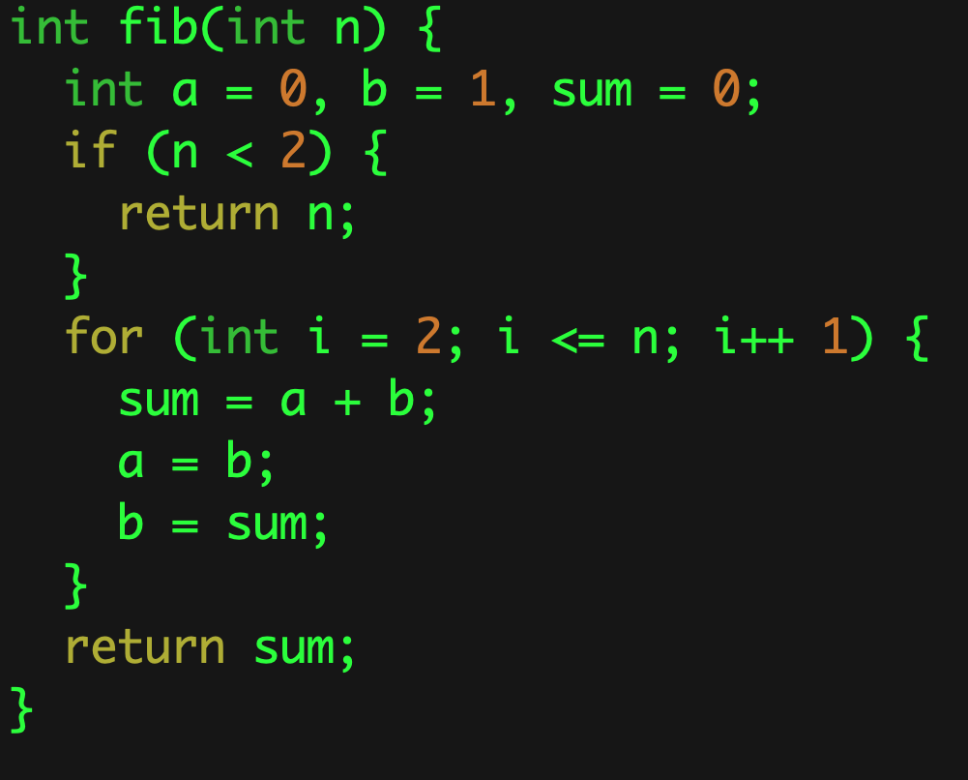

Same Value — Different Algorithm
$$O(n)$$

Slide 22
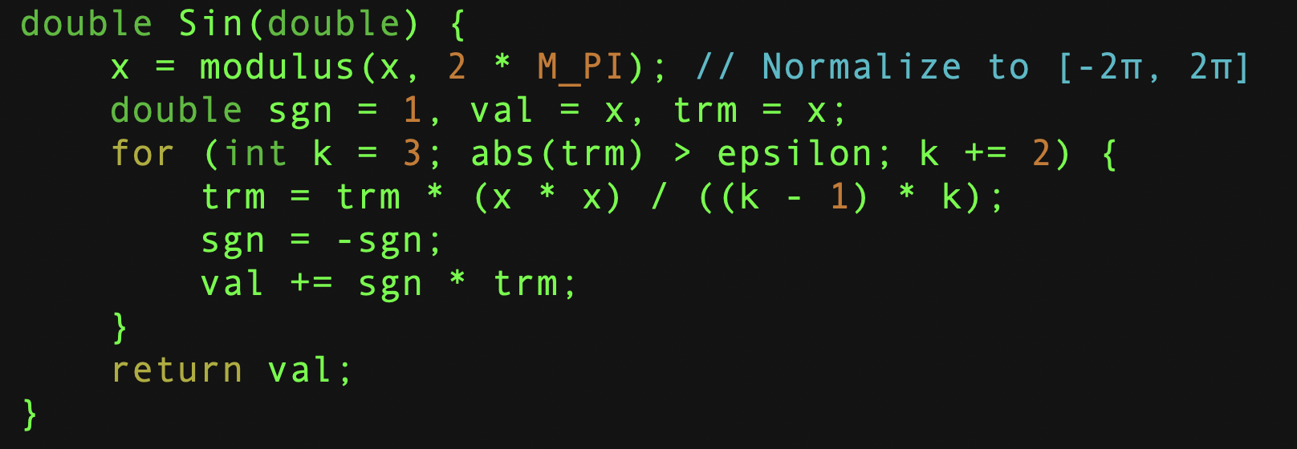
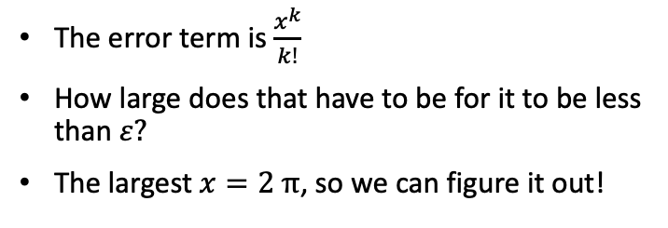
What about this?
The error term is $\frac{x^{k}}{k!}$
How large does that have to be for it to be less than $ε?$
The largest $x=2 π$, so we can figure it out!

Slide 23
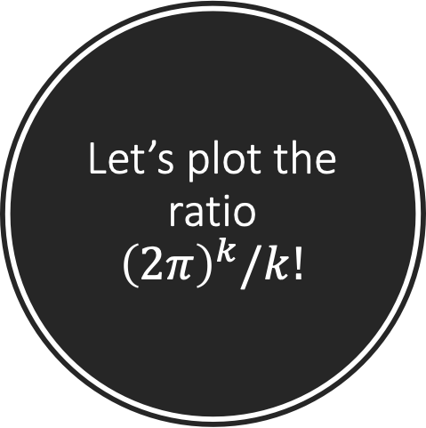
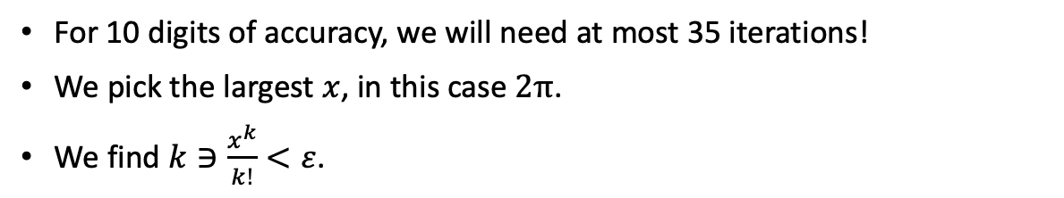
Let’s plot the ratio ${\left(2π\right)}^{k}/k!$
For 10 digits of accuracy, we will need at most 35 iterations!
We pick the largest $x$, in this case $2π$.
We find $k∋\frac{x^{k}}{k!}<ε$.

Slide 24
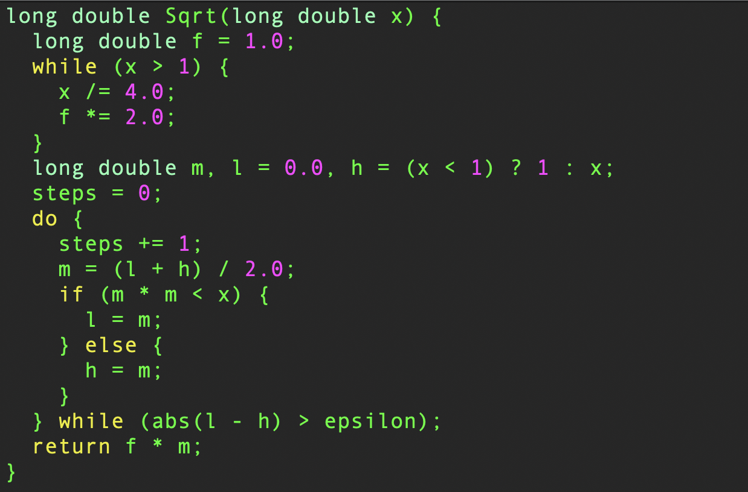
And what about this?
Notes:
Suppose 𝛜 – 1e-14, then there are 1e14 partitions. How many times can we divide that by 2? log(1e14)/log(2) ~ 47.

Slide 25
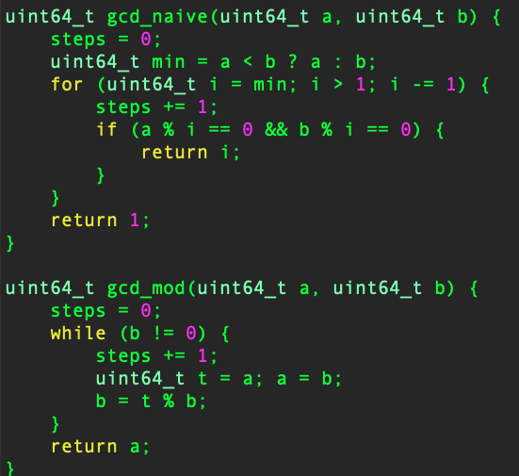
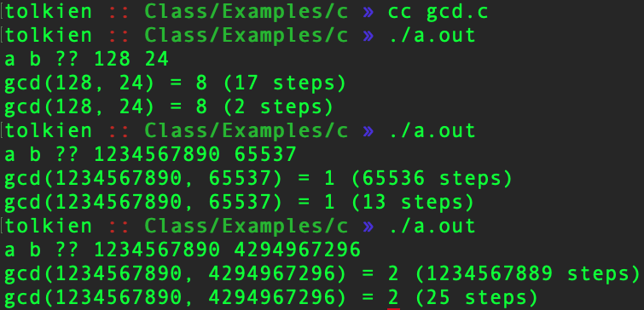
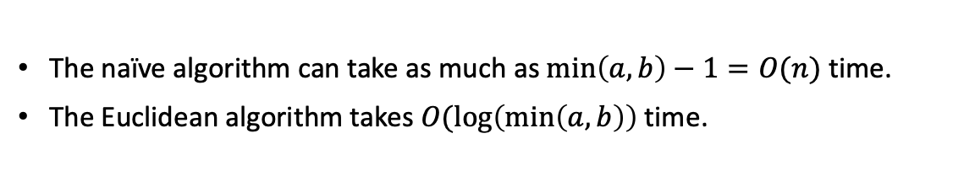
And these?
The naïve algorithm can take as much as $\min\left(a, b\right)−1=O(n)$ time.
The Euclidean algorithm takes $O(\log\left(\min\left(a,b\right)\right)$ time.

Slide 26
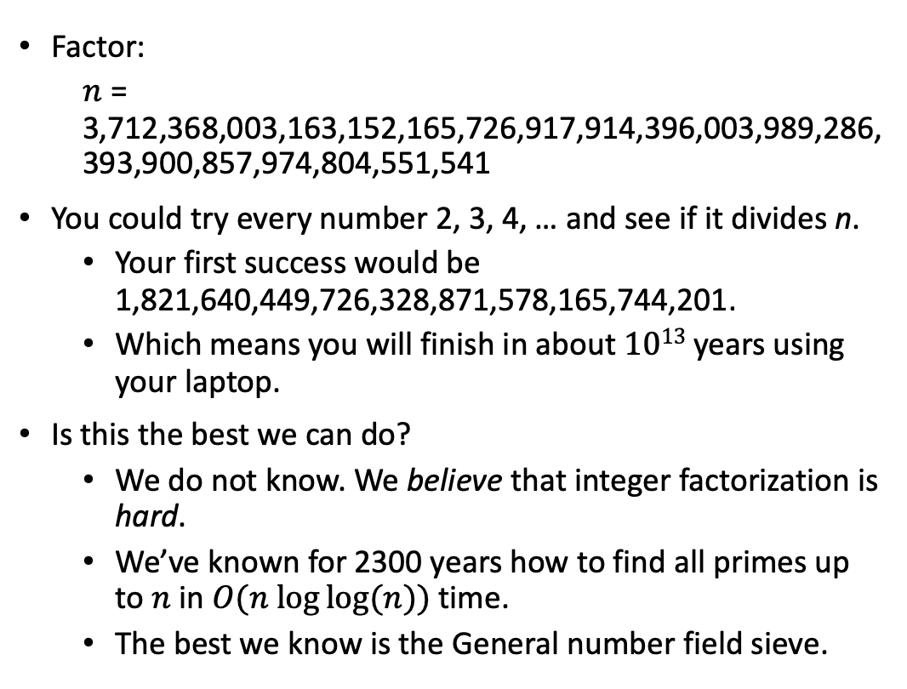
An Extreme Example
Factor:
$n$ = 3,712,368,003,163,152,165,726,917,914,396,003,989,286,393,900,857,974,804,551,541
You could try every number 2, 3, 4, … and see if it divides n.
Your first success would be 1,821,640,449,726,328,871,578,165,744,201.
Which means you will finish in about $1013$ years using your laptop.
Is this the best we can do?
We do not know. We believe that integer factorization is hard.
We’ve known for 2300 years how to find all primes up to $n$ in $O(n log⁡log⁡(n))$time.
The best we know is the General number field sieve.

Slide 27
Summary
Computer Scientists talk about the complexity of algorithms all the time.
Complexity can measure time, space or both.
Time is “how many steps it takes” and
Space is “how much memory it uses”.
The algorithm that you choose has the largest impact on the performance of your program.
For small problems, it may be better to use a worse algorithm if the better algorithm that a larger constant.
But you need to take the time and examine it carefully.

